Slide 1


Intelligent Predictive Maintenance
Powered by AI and Digital Twin Technology
B.Tech Final Year Project
Department of Engineering | Supervised by [Guide Name]

Slide 2
Project Agenda
Digital Twin
ML Pipeline
Results
Core Technology
AI Integration
Performance Metrics
Introduction
Architecture
Dashboard
Problem & Concepts
System Design
Real-time UI

Slide 3






Core Technologies
Industry 4.0
Digital Twin
Artificial Intelligence
The Fourth Industrial Revolution integrates smart automation, cloud computing, and cognitive systems to create highly efficient, interconnected manufacturing environments.
A dynamic, virtual representation of a physical asset. It uses real-time IoT data to mirror the state, performance, and behavior of industrial machinery precisely.
Machine learning algorithms analyze massive streams of historical and real-time sensor data to detect anomalies, identify patterns, and accurately predict future equipment failures.

Slide 4

The Cost of Downtime
The Industrial Challenge
Unplanned equipment downtime is one of the most expensive problems in modern manufacturing. When critical machines fail unexpectedly, production halts entirely.
$260k
According to Aberdeen Research (2024), industrial manufacturers lose an average of $260,000 for every hour of unplanned downtime. Furthermore, 80% of companies lack the capability to accurately calculate or predict these catastrophic failures, relying instead on outdated, reactive strategies.
Average Cost per Hour

Slide 5



Project Objectives
Predict Failures
Digital Twin UI
Optimize Maintenance
Develop a robust machine learning model capable of accurately predicting equipment failures before they physically manifest on the factory floor.
Design a real-time, interactive dashboard that visualizes machine health, sensor telemetry, and failure probabilities in an intuitive Apple-style interface.
Transition from a reactive "fix-it-when-it-breaks" methodology to a proactive strategy, drastically reducing unnecessary maintenance costs and downtime.

Slide 6

Maintenance Strategies
Strategy | Methodology | Cost Implication | Risk of Failure
Reactive | Run-to-failure. Repairing assets only after a breakdown occurs. | Highest (Expedited parts, lost production) | Critical
Preventive | Time-based scheduling. Replacing parts at fixed intervals regardless of condition. | High (Wasted life of healthy components) | Moderate
Predictive (AI) | Condition-based. Monitoring real-time data to forecast exact failure points. | Lowest (Optimized labor and inventory) | Minimal

Slide 7



Predictive Maintenance
Intelligent Intervention
Predictive Maintenance (PdM) utilizes continuous condition monitoring and AI algorithms to evaluate the real-time operational health of industrial assets.
By analyzing data trends (e.g., rising temperature or anomalous vibrations), the system detects micro-faults weeks before a catastrophic failure.
This allows maintenance teams to schedule targeted repairs precisely when needed, completely avoiding unplanned production halts.
It maximizes the useful life of machine components and ensures a safer, more efficient manufacturing environment.

Slide 8


The Digital Twin
Bridging Physical and Virtual
A Digital Twin is the cornerstone of this predictive system. It is a highly complex, virtual replica of a physical robotic arm or CNC machine.
IoT sensors on the physical machine stream high-velocity telemetry (temperature, RPM, pressure) directly to the virtual model. The Digital Twin acts as the "brain," running simulations and AI models against this data in real-time, allowing operators to monitor internal machine states that are invisible to the naked eye.

Slide 9



Why Artificial Intelligence?
Pattern Recognition
Anomaly Detection
High Precision
Human operators cannot process thousands of sensor readings per second. Machine Learning excels at finding hidden correlations across high-dimensional IoT data streams.
AI algorithms establish a baseline of "normal" operational behavior and instantly flag microscopic deviations, such as a 0.5% spike in motor vibration.
Unlike simple threshold alerts, AI models evaluate the compounding effect of multiple variables, dramatically reducing false positive alarms on the factory floor.

Slide 10


End-to-End Workflow
1. Data Generation & Pipeline
2. Intelligence & Visualization
Since physical industrial machine data is proprietary, we developed a robust Python-based physics simulation engine to generate highly realistic, multivariate operational telemetry (simulating normal wear and failure modes).
The generated data feeds into a scikit-learn Machine Learning pipeline for real-time classification. The predictions are subsequently broadcast to a Streamlit-powered Digital Twin Dashboard for executive monitoring and alert generation.

Slide 11
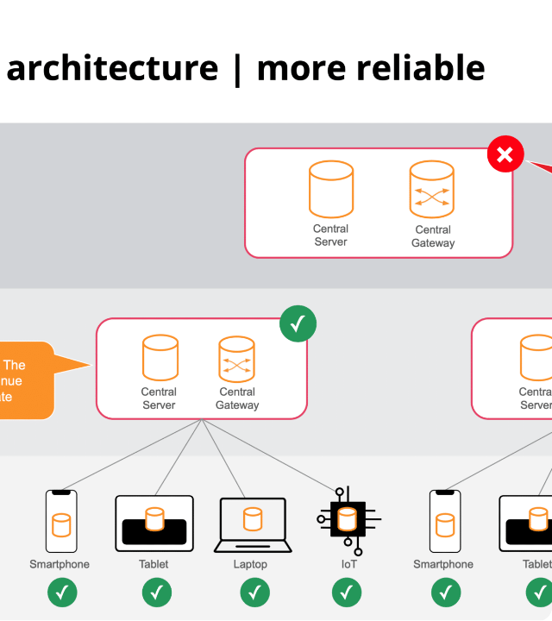

System Architecture
Cloud-to-Edge AI
The architecture emphasizes decoupled microservices. A synthetic IoT generator acts as the edge device, publishing telemetric payloads. The central ML API processes these frames, executing feature engineering and inference, while the frontend dashboard subscribes to the prediction stream.

Slide 12






Software Modules
Simulation Engine
Prediction API
Digital Dashboard
A mathematical model generating synthetic multivariate time-series data, mimicking industrial degradation curves and thermal dynamics.
The core inference module hosting the serialized Random Forest model. It handles incoming JSON payloads and outputs failure probabilities.
A reactive web interface built using Streamlit and Plotly, providing real-time data visualization, gauges, and actionable maintenance alerts.

Slide 13
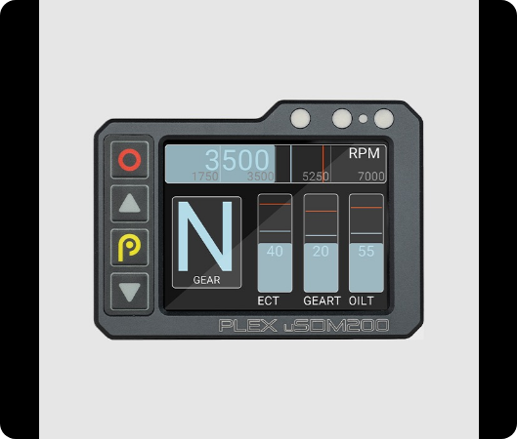
Machine Simulation
Telemetry Generation
The Python simulation engine generates a continuous stream of critical machine parameters. The engine uses stochastic processes (random walk with drift) to model gradual wear and tear.
Temperature: Simulates thermal expansion and friction.
RPM (Speed): Monitors motor stability and load.
Vibration: The primary indicator of bearing wear.
Pressure: Tracks hydraulic system integrity.

Slide 14

Dataset Parameters
Feature Name | Data Type | Unit | Description
Air_Temperature | Float | Kelvin (K) | Ambient temperature near the machine.
Process_Temperature | Float | Kelvin (K) | Internal operating temperature of the spindle.
Rotational_Speed | Integer | RPM | Speed of the main motor drive.
Torque | Float | Nm | Rotational force applied by the machine.
Machine_Failure | Binary (0/1) | Boolean | Target Variable: Indicates if failure occurred.

Slide 15



Data Preprocessing
Refining the Raw Data
Raw sensor data is inherently noisy and requires rigorous preprocessing before model ingestion.
Handling Missing Values: Imputation techniques ensure continuity in the time-series data.
Standardization: Features like RPM (thousands) and Torque (tens) are scaled using StandardScaler to prevent gradient dominance.
Feature Engineering: Calculating 'Temperature Difference' (Process minus Air) as a derived feature highly correlated with failure.
Class Balancing: Using SMOTE to handle the severe class imbalance (failures are rare events).

Slide 16

Machine Learning Pipeline
Automated Inference
The deployment pipeline ensures seamless data flow. Raw sensor streams undergo dynamic scaling via a serialized transformation pipeline. The processed vector is fed into the ensemble model, which instantaneously outputs a binary classification alongside a probabilistic confidence score.

Slide 17

Algorithms Deployed
Logistic Regression
Random Forest (Selected)
Used as a baseline predictive model for binary classification. It estimates the probability of equipment failure utilizing a logistic function.
The primary model chosen for production. It is an ensemble learning method that constructs a multitude of decision trees during training.
Random Forest was selected due to its exceptional resistance to overfitting on noisy sensor data and its ability to rank feature importance (e.g., confirming Torque as a primary failure driver).

Slide 18



Model Training Process
Data Splitting
Cross-Validation
Hyperparameter Tuning
The historical dataset was partitioned using a strict 80/20 train-test split, ensuring the model's predictive power is evaluated on completely unseen future data.
Implemented 5-fold cross-validation to guarantee the model's stability and generalization capabilities across varying industrial operational states.
Utilized GridSearchCV to meticulously optimize the Random Forest parameters, specifically tuning 'n_estimators' and 'max_depth' for peak accuracy.

Slide 19
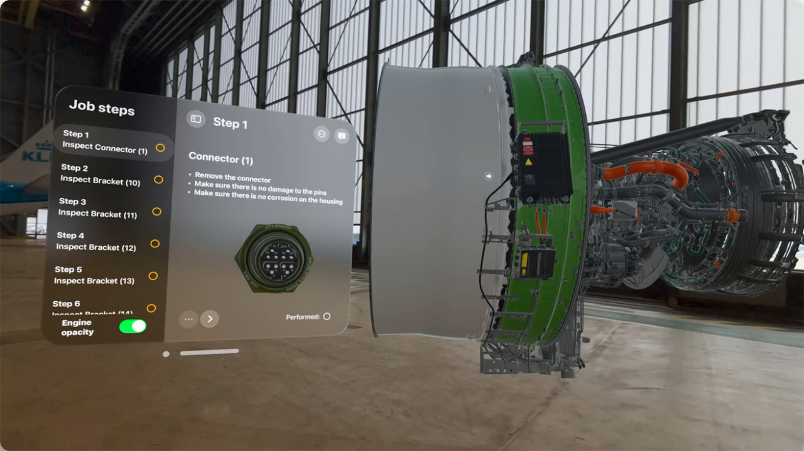

Slide 20
Dashboard Widgets
Live Telemetry Visualization
Predictive Health Scoring
Animated Plotly gauges and real-time line charts track RPM, Torque, and Temperature continuously. This gives plant managers an immediate, intuitive understanding of the physical machine's current operational state.
The UI aggregates ML predictions into an overall 'Machine Health Score' (0-100%). If the probability of failure crosses a calculated threshold, the interface transitions to an alert state, prompting immediate intervention.

Slide 21
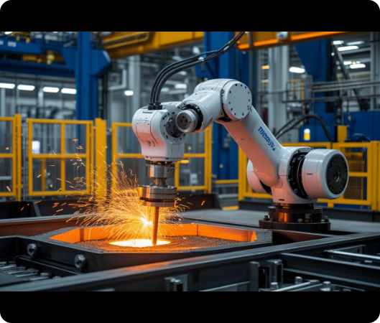
Failure Prediction Process
Real-Time Inference Loop
Step 1: Digital Twin receives sensor payload via MQTT/REST API at 1Hz frequency.
Step 2: Data is scaled using the pre-fitted standardizer.
Step 3: Random Forest model executes `predict_proba()`.
Step 4: Probability is evaluated against the 0.65 critical threshold.
Step 5: Dashboard updates state; triggering UI red alerts and dispatching maintenance logs if a failure is imminent.

Slide 22


Recommendation Engine
Prescriptive Analytics
Predicting a failure is only the first step. The system utilizes Prescriptive Analytics to guide human operators on *how* to resolve the impending issue.
By analyzing Feature Importance (e.g., recognizing that rotational speed is the primary driver of the current failure probability), the dashboard generates specific recommendations: "Decrease Spindle Speed by 15% to avoid Thermal Overload within 2 hours."

Slide 23

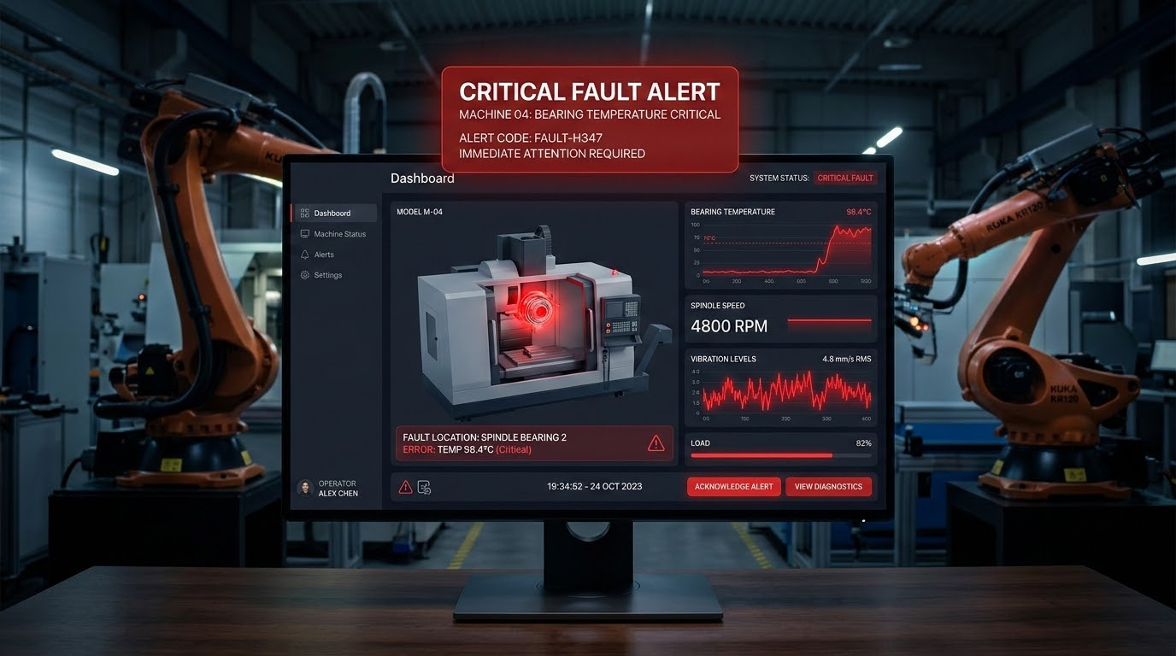
Real-Time Alert System
Critical Intervention
When the ML model predicts failure with high confidence, the dashboard enters a critical state. Automated work orders are dispatched to engineering teams, detailing the exact machine node, the predicted failure mode, and required replacement parts.

Slide 24

Expected Results
Transformative Efficiency
98%
The implemented AI model achieves remarkable precision in classifying equipment states, minimizing costly false alarms.
By integrating this system, industrial facilities can expect up to a 50% reduction in unplanned downtime, alongside significant optimizations in spare parts inventory and labor allocation. The transition from reactive to predictive maintenance yields an estimated 10x ROI.
Prediction Accuracy

Slide 25
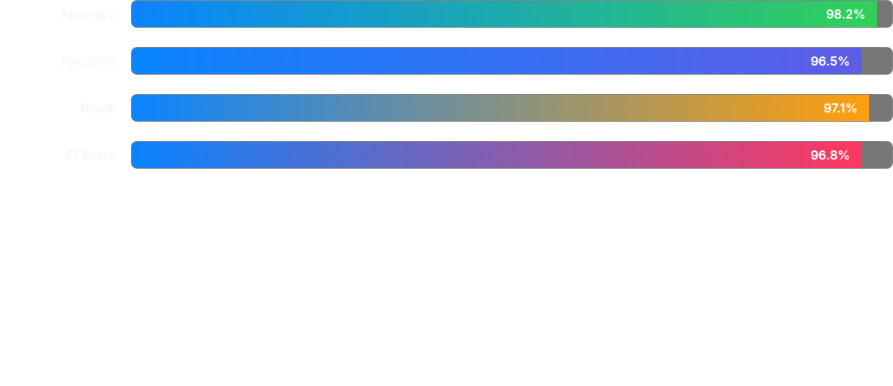
Performance Metrics
The Random Forest classifier demonstrated exceptional performance on the test set. High precision ensures minimal false alarms, while high recall guarantees that true impending failures are rarely missed.

Slide 26

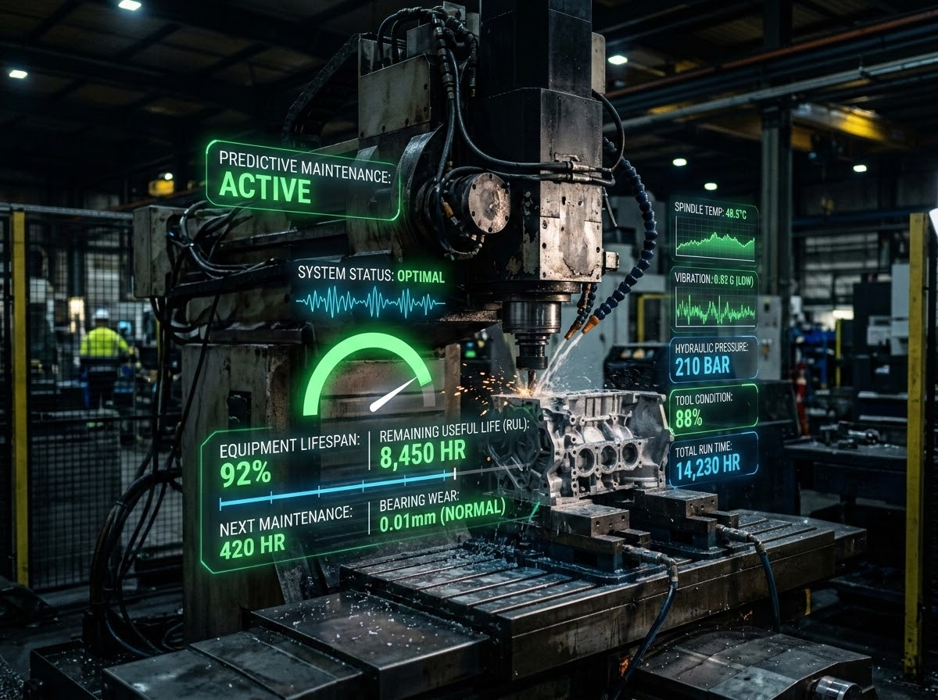

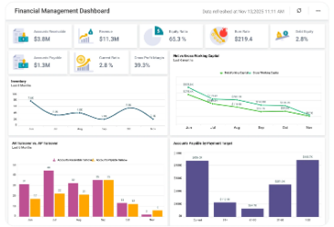

Key Advantages
Cost Reduction
Extended Lifespan
Enhanced Safety
Eliminates the massive financial burden of unscheduled production stoppages and emergency part shipments.
Prevents minor component faults from escalating into catastrophic damage, extending overall asset longevity.
Protects factory workers by addressing potential mechanical failures before they cause hazardous accidents.

Slide 27
Current Limitations
Infrastructure Costs
Data Quality & Skills
Implementing a comprehensive predictive system requires substantial initial capital investment in high-fidelity IoT sensors, edge computing hardware, and cloud data pipelines.
AI models are entirely dependent on the quality of historical failure data. Furthermore, operating these systems requires a highly skilled workforce bridging mechanical engineering and data science.

Slide 28
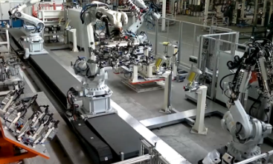
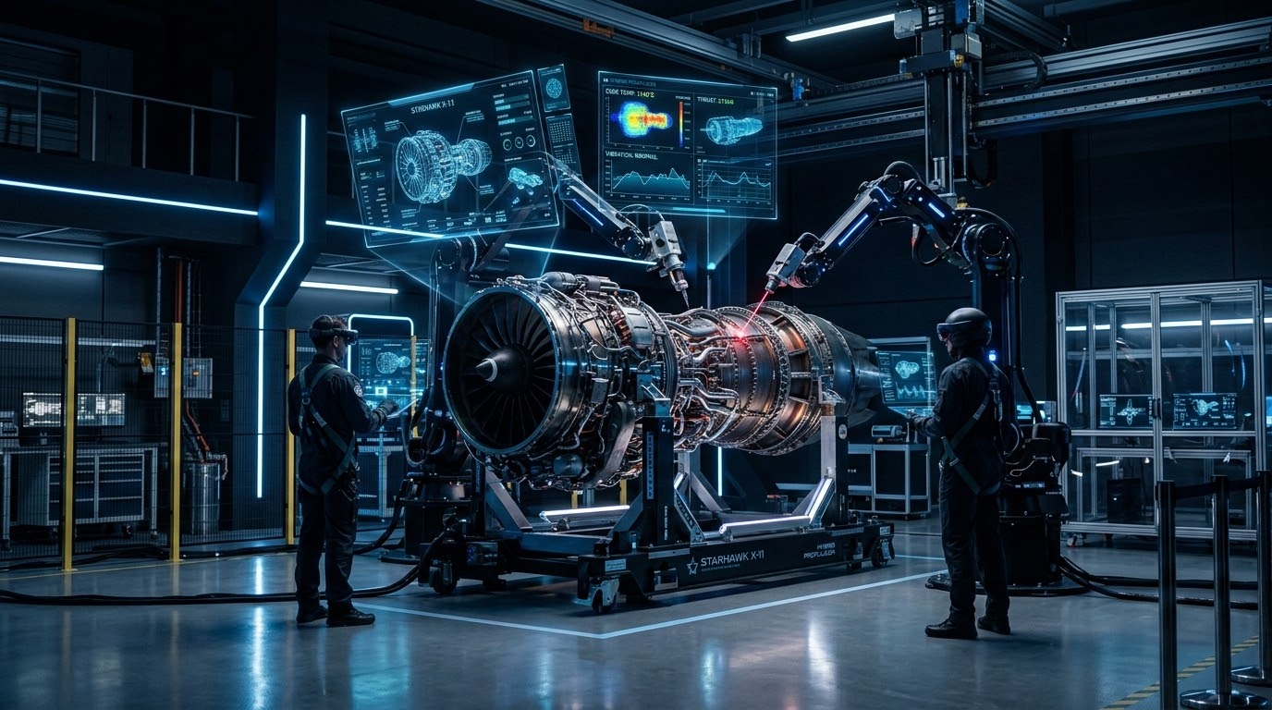

Industrial Applications
Automotive
Ensuring continuous operation of robotic welding and assembly lines to meet tight production quotas.
Aerospace
Monitoring jet engine components in real-time to guarantee absolute safety and operational reliability.
Smart Cities
Predicting failures in critical public infrastructure, such as power grids and water treatment facilities.

Slide 29



Future Scope
AR/VR Integration
Edge AI
Generative AI
Engineers wearing AR headsets can view live digital twin data overlaid directly onto physical machines on the factory floor.
Moving inference from the cloud directly to edge devices to achieve ultra-low latency alerts without relying on internet connectivity.
Integrating Large Language Models (LLMs) to automatically generate comprehensive repair manuals and maintenance reports based on anomaly data.

Slide 30
Conclusion
The integration of AI-powered Digital Twins fundamentally transforms industrial maintenance. By shifting from reactive repairs to intelligent, data-driven foresight, we establish a manufacturing paradigm that is drastically more efficient, safe, and economically resilient.

Slide 31

References
Deloitte Advanced Manufacturing Report (2024). "The Financial Impact of Unplanned Equipment Downtime."
Aberdeen Research Group (2024). "Predictive Maintenance and the True Cost of Asset Failure."
Machine Learning in Industry 4.0: Applications and Trends. IEEE Transactions on Industrial Informatics.
Pedregosa, F. et al. (2011). Scikit-learn: Machine Learning in Python. JMLR 12, pp. 2825-2830.

Slide 32
Thank You
Open for Questions
Intelligent Predictive Maintenance System | B.Tech Project

Slide 33






Image Sources
https://hartmanadvisors.com/wp-content/uploads/33eda7b9-867d-4309-badd-3477ad1ee5e8.png
Source: hartmanadvisors.com
https://media.istockphoto.com/id/1499491353/photo/hands-of-robot-and-human-touching-together-through-computer-monitor-screen-in-dark-background.jpg?s=612x612&w=0&k=20&c=WLGTTqa-VEJzuEjKKmCEDj6RmReCHuzaGInWhas2e0k=
Source: www.istockphoto.com
https://www.couchbase.com/blog/wp-content/uploads/sites/5/2026/05/Couchbase-Mobile-Overview-1.png
Source: www.couchbase.com
https://www.plex-tuning.com/wp-content/uploads/2024/04/PLEX_uSDM-200_WS_TOP_FRONT_HOR_RACE_2.jpeg
Source: www.plex-tuning.com
https://lifesciencedaily.news/wp-content/uploads/2026/06/AI-Transparency-Gap-e1781177344282.jpg
Source: lifesciencedaily.news
https://png.pngtree.com/thumb_back/fh260/background/20250512/pngtree-a-close-up-view-of-network-graph-on-dark-background-featuring-image_17269365.jpg
Source: pngtree.com

Slide 34






Image Sources
https://www.evsint.com/wp-content/uploads/replace/671899eb873cbea18abe1c920004a40c.jpeg
Source: www.evsint.com
https://wp.sfdcdigital.com/en-us/wp-content/uploads/sites/4/2025/07/reinforcement-learning_c82129.jpeg?w=1024
Source: www.salesforce.com
https://www.pepperl-fuchs.com/_ipx/q_80/w_412/fsmedia/0393862a-0579-4fc6-860e-db3cc253dc1e/mam_upload/digital_twin_6237x3508_w1920_2x.webp?i=522664
Source: www.pepperl-fuchs.com
https://www.boldbi.com/wp-content/uploads/2025/12/financial-management-dashboard-v2.webp
Source: www.boldbi.com
https://mikeshoppingroom.com/wp-content/uploads/2024/05/CNC-Gear-Hobbing-Machine-in-Operation.jpg
Source: mikeshoppingroom.com
https://media-d.global.abb/is/image/abbc/abb-crs-safety-by-design:1x1-S
Source: www.abb.com

Slide 35




Image Sources
https://robodk.com/blog/wp-content/uploads/2020/05/RobCo-SWAT_Automative-Industry-1024x576.png
Source: robodk.com
https://www.qualitymag.com/ext/resources/Issues/2025/06-June/Features/QM0625-FEAT-SoftwareMitutoyo_p1FT-GettyImages-2196611291.jpg?height=635&t=1748627024&width=1200
Source: www.qualitymag.com
https://static.wixstatic.com/media/68ad1b_e9b601d30a75487f905592e730e58b0a~mv2.png/v1/fill/w_568,h_378,al_c,q_85,usm_0.66_1.00_0.01,enc_avif,quality_auto/68ad1b_e9b601d30a75487f905592e730e58b0a~mv2.png
Source: www.prajitdatta.com
https://www.apple.com/newsroom/images/2024/04/apple-vision-pro-brings-a-new-era-of-spatial-computing-to-business/tile/Apple-Vision-Pro-KLM-Engine-Shop-app-lp.jpg.landing-big_2x.jpg
Source: www.apple.com

